Slide 1


INDUSTRIAL SAFETY AND HEALTH ACCIDENT
Accident Statistics Analysis
INDUSTRIAL SAFETY AND HEALTH ACCIDENT
INDUSTRIAL SAFETY AND HEALTH ACCIDENT ANALYSIS
Nguzo Uche

Slide 2
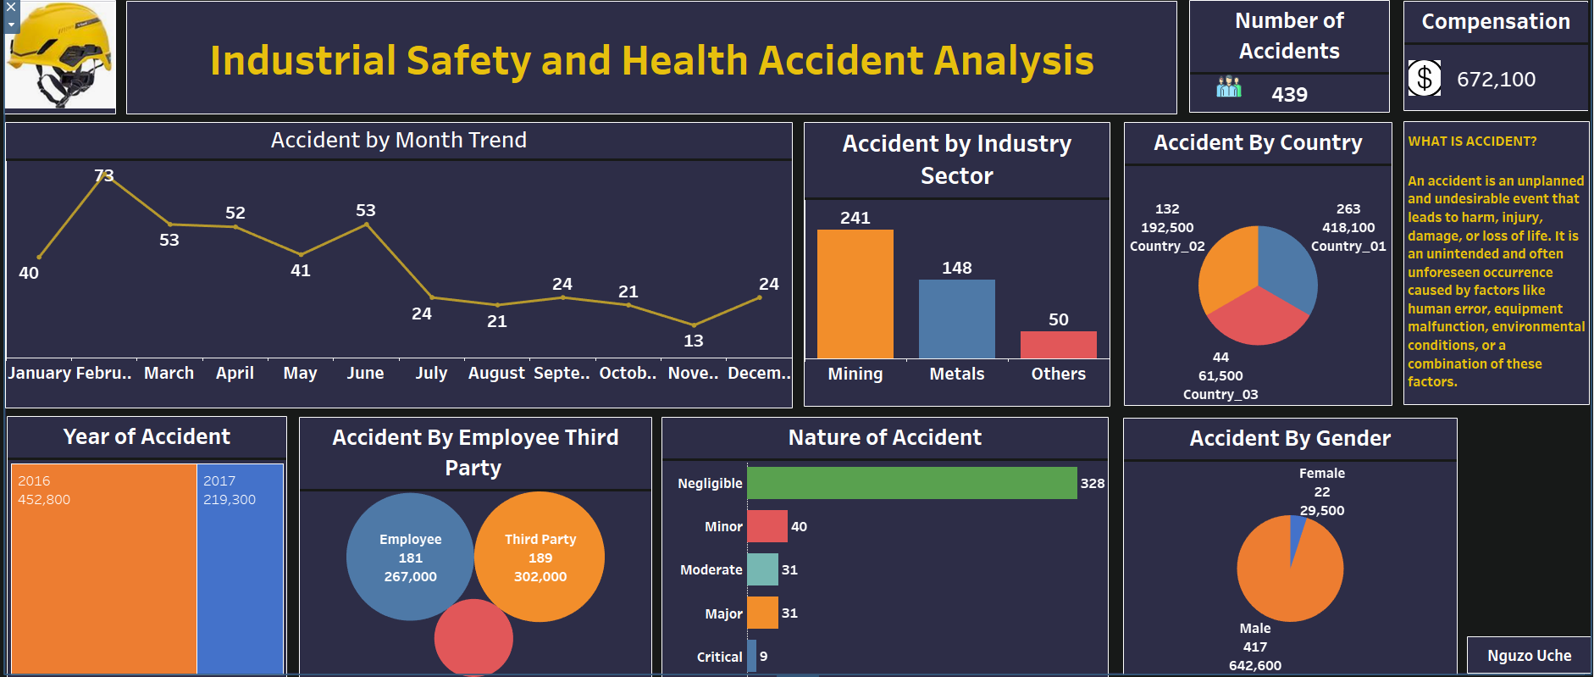
EXECUTIVE SUMMARY
The total number of accidents involved with the two years review was 439 and total compensation claim was $672,100
February had the highest number of accidents with 73 occurrences, followed by March and April.
November recorded the lowest number of accidents at 13 incidents.
February's accident rate was 369% higher than November's, indicating a significant difference in safety performance.
Negligible cases accounted for 59% of all Worker's Compensation claims.
Worker's Compensation amounts varied across all 5 Nature of Accidents, ranging from $32,000 to $379,200.
INDUSTRIAL SAFETY AND HEALTH ACCIDENT ANALYSIS

Slide 3
PROJECT OBJECTIVES
To investigate the sector of the industry that more accidents or incidents
occurred.
To identify the nature of accidents and which among them has the highest occurrence.
To find out which country recorded the highest number of incidence.
To determine how much spent on accident compensation.
To identify the number of persons involved in accidents within the period.
To determine the least and most accident trend.
INDUSTRIAL SAFETY AND HEALTH ACCIDENT

Slide 4
ACCIDENT MONTH TREND
February had the highest number of accidents with 73 occurrences, followed by March and April.
November recorded the lowest number of accidents at 13 incidents.
February's accident rate was 369% higher than November's, indicating a significant difference in safety performance.
INDUSTRIAL SAFETY AND HEALTH ACCIDENT ANALYSIS

Slide 5
ACCIDENT BY GENDER
INDUSTRIAL SAFETY AND HEALTH ACCIDENT ANALYSIS
Gender Distribution: The report highlights that male accounted for an overwhelming 95% of the total accidents while female is 5%. This indicates a significant male majority in the incidents recorded.

Slide 6
Distribution across Accident Levels
Across the five Nature of Accident categories, the number of accidents varied significantly, ranging from 9 to 328.
This suggests that there is diversity in the severity or classification of accidents, with certain categories experiencing a higher incidence rate than others.
Negligible cases accounted for 59% of all the accident.
NATURE OF ACCIDENT
INDUSTRIAL SAFETY AND HEALTH ACCIDENT ANALYSIS

Slide 7
ACCIDEBT BY INDUSTRY SECTOR
The breakdown of accidents by industry sector is as follows:
Mining: = 55%
Metal: = 34%
Others: = 11%
The above indicates that more than half of the accidents happened in the Mining Sector.
The result can help to prioritize safety measures and resource allocation accordingly.
INDUSTRIAL SAFETY AND HEALTH ACCIDENT ANALYSIS
INDUSTRIAL SAFETY AND HEALTH ACCIDENT ANALYSIS

Slide 8
INVESTIGATION PLAN
Form a cross-functional investigation team to analyze the February accident data.
Identify potential root causes, such as equipment failure, human error, or environmental
factors.
Conduct interviews with involved personnel and witnesses to gather insights.
Review maintenance records and safety procedures for any deviations or gaps.
Implement corrective actions based on the investigation findings
INDUSTRIAL SAFETY AND HEALTH ACCIDENT ANALYSIS

Slide 9
SAFETY IMPROVEMENT MEASURES
Enhance safety training programs to address identified risk factors.
Regularly review and update safety protocols to align with industry best practices.
Increase the frequency of equipment maintenance and inspections.
Establish a reporting system to encourage employees to report near-misses and potential
hazards.
Conduct periodic safety audits to ensure compliance with safety standards.
INDUSTRIAL SAFETY AND HEALTH ACCIDENT ANALYSIS

Slide 10
RECOMMENDATIONS
Conduct a thorough investigation into the factors contributing to the high number of
accidents in February.
Analyze the causes behind the low accident rate in November and identify best practices to
maintain this level of safety performance.
Review safety protocols and implement preventive measures to reduce the occurrence of
accidents across all months.
Enhance safety training programs to address the specific risk factors identified during the
analysis.
Allocate resources towards improving safety measures and equipment maintenance.
INDUSTRIAL SAFETY AND HEALTH ACCIDENT ANALYSIS

Slide 11
CONCLUSION
Safety is a continuous improvement exercise that requires all stakeholders participation to maintain
zero accident in the workplace.
Comprehensive safety training and its implementation is cogent in any environment prone to hazard.
It is recommended to investigate the causes behind the high accident rate in February, identify
preventive measures, and improve safety protocols to maintain optimal safety performance throughout
the year/s.
INDUSTRIAL SAFETY AND HEALTH ACCIDENT ANALYSIS

